Slide 1

Unit 5: Culture spot 5
Iceless Canada?

Slide 2
Task 1: Read the quotation and explain its meaning
Klimatske promjene nisu više samo proročanstvo – one su stvarnost.

Slide 3
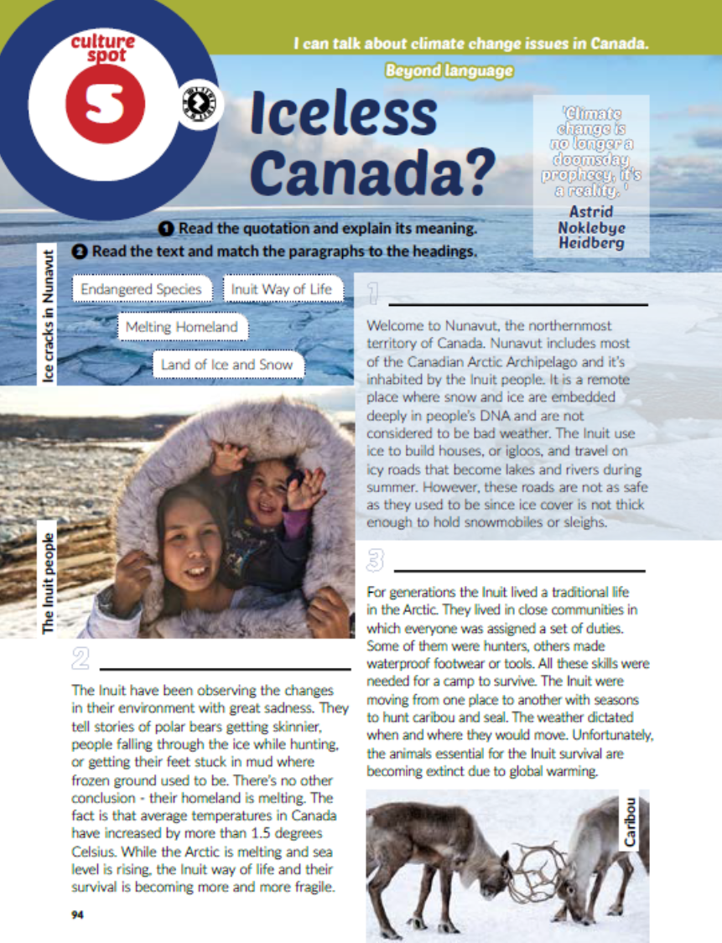
Task 2: Read the text and match the paragraphs to the headings.
Land of Ice and Snow
Endangered Species
Inuit Way of Life
Melting Homeland

Slide 4
Task 3: How is global warming affecting Canada? What will disappear?
Task 4: What can be done to stop climate change?
Task 5: How is climate change affecting Croatia? Go online and do some research.

Slide 5
workbook, page 99
Task 1: Circle the correct answer.

Slide 6

PLAY AND LEARN!
https://www.e-sfera.hr/dodatni-digitalni-sadrzaji/50365cef-7c1c-44cd-8fd5-1c7f999e6b20/

